Slide 1
CS60055: Ubiquitous Computing
Context Sensing

Slide 2
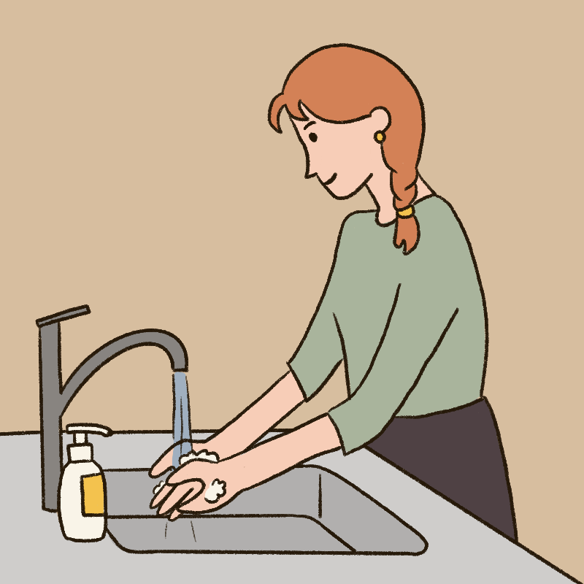
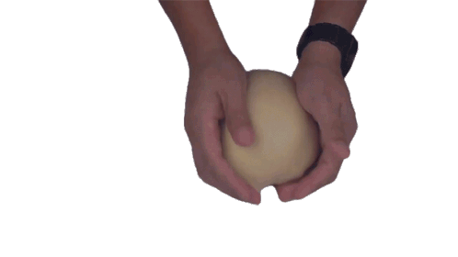
What is Context in Ubiquitous Computing?
Any relevant information about the environment, user, or device that can influence the behavior of an application or system
Examples: Several activities have similar patterns

Slide 3
What is Context in Ubiquitous Computing?
Location information can help differentiating such activities: Kitchen vs Washroom
Any relevant information about the environment, user, or device that can influence the behavior of an application or system
Examples: Several activities have similar patterns

Slide 4
Some Key Context Information
Location
  Information about where the user or device is physically located
Identity
  Details about who is involved, which might include information about the user, their preferences, profiles, or other identifying attributes that can help tailor the system's responses
Time
  The time at which an interaction occurs.
  Time can include aspects such as the current date and time of day or more abstract notions like a user’s schedule or the duration of an interaction.

Slide 5
Some Key Context Information
Activity
  Information about what the user is doing or the current state of an environment.
  This can include activities such as walking, driving, working, or interacting with a particular device.

Slide 6
Examples
Virtual assistants like Siri or Google Assistant use context such as user location, calendar events, and habits to provide relevant reminders or recommendations.
Wearable devices can track users' physiological data (like heart rate or movement) and use context such as location (e.g., at home vs. exercising outdoors) to interpret health metrics accurately and provide appropriate feedback.
In a smart home, the system may use context such as the time of day, user presence, and current activity to automatically adjust lighting, temperature, and security settings.

Slide 7
Context-aware Computing
Systems and applications are designed to dynamically adapt their behavior based on contextual information
  being aware of the current context and possibly anticipating future needs based on that context
Examples:
  In a smart office, context-aware applications could detect if a user is in a meeting and automatically set their phone to silent mode
  In a smart city scenario, public transportation systems might adapt schedules based on real-time context such as traffic conditions or weather.

Slide 8
Types of Context
Explicit Context: Information that the user directly provides or that is easily obtained, such as location coordinates from GPS
Implicit Context: Information inferred from user behavior, patterns, or machine learning algorithms, such as detecting a user’s activity (e.g., jogging or sitting) based on accelerometer data

Slide 9
Context Sensing Modalities
Personal/human-centric Sensing
  Device user is the point of interest
  Example: Monitoring and recognition of user related posture and movement patterns for personal fitness log
Participatory Sensing
  Relies on multiple deployment of mobile devices to interactively and intentionally share, gather and analyze of each local knowledge that is not solely based on a human activity, but also based on surrounding environment
  Example: Delivering an intelligent traffic congestion report in case where many users provide their speed and location information

Slide 10
Context Sensing Modalities
Opportunistic Sensing
  Collects sensory data in a fully autonomous way without active user interaction (runs as a background service)
  Example: Ambient sound recognition (Siri)

Slide 11
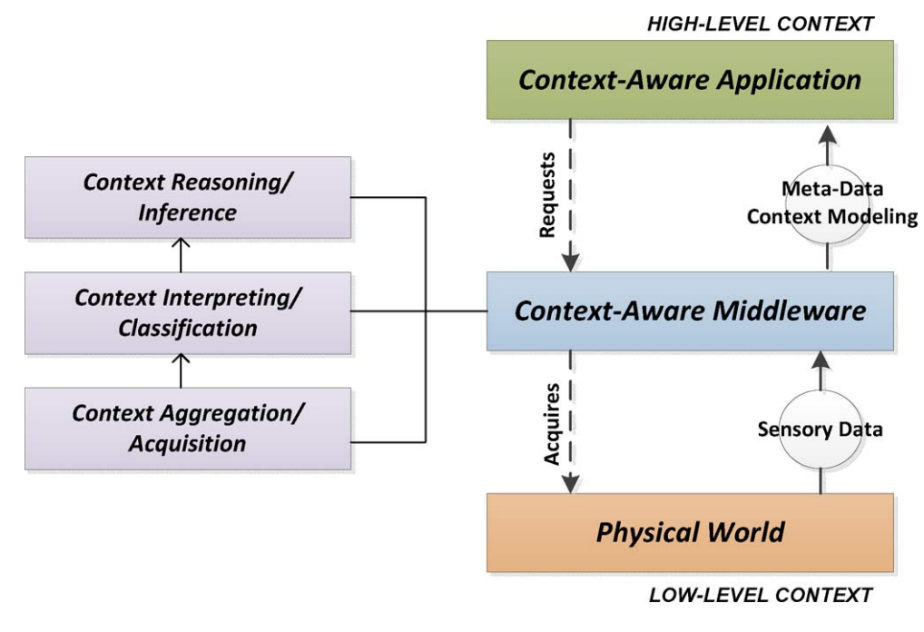
General Architecture of a Context-Aware System
Source: https://ieeexplore.ieee.org/stamp/stamp.jsp?arnumber=6985718

Slide 12
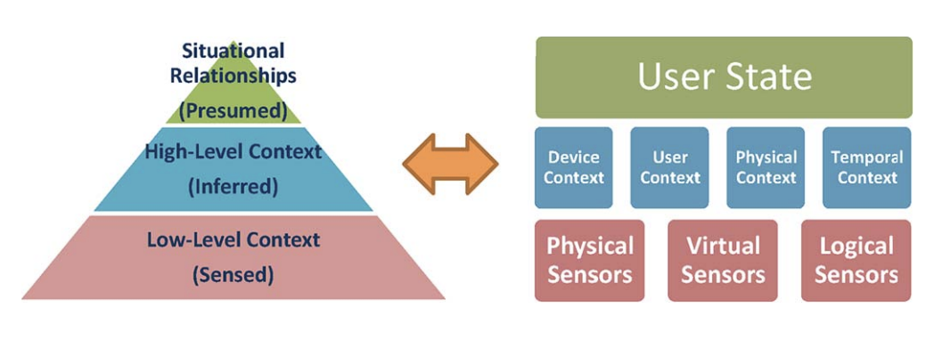
Hierarchical Representation of Context
Source: https://ieeexplore.ieee.org/stamp/stamp.jsp?arnumber=6985718

Slide 13
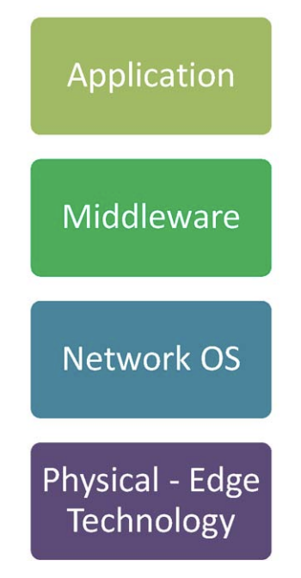
Context-aware Middleware
A layered system architecture that can response effectively for optimal sensor utilization, large sensory data acquisitions as well as meeting application requirements
  leverages the pervasive context-processing software libraries
  Considers mobile device resource constraints while handling
  context analysis and context feedback to the applications
Creates a shielded interface
  Enhances the level of abstraction support needed by the
  application
  Hides lower layer operations between the physical layer
  (i.e., hardware and communications) at the bottom and
  the application layer at the top

Slide 14
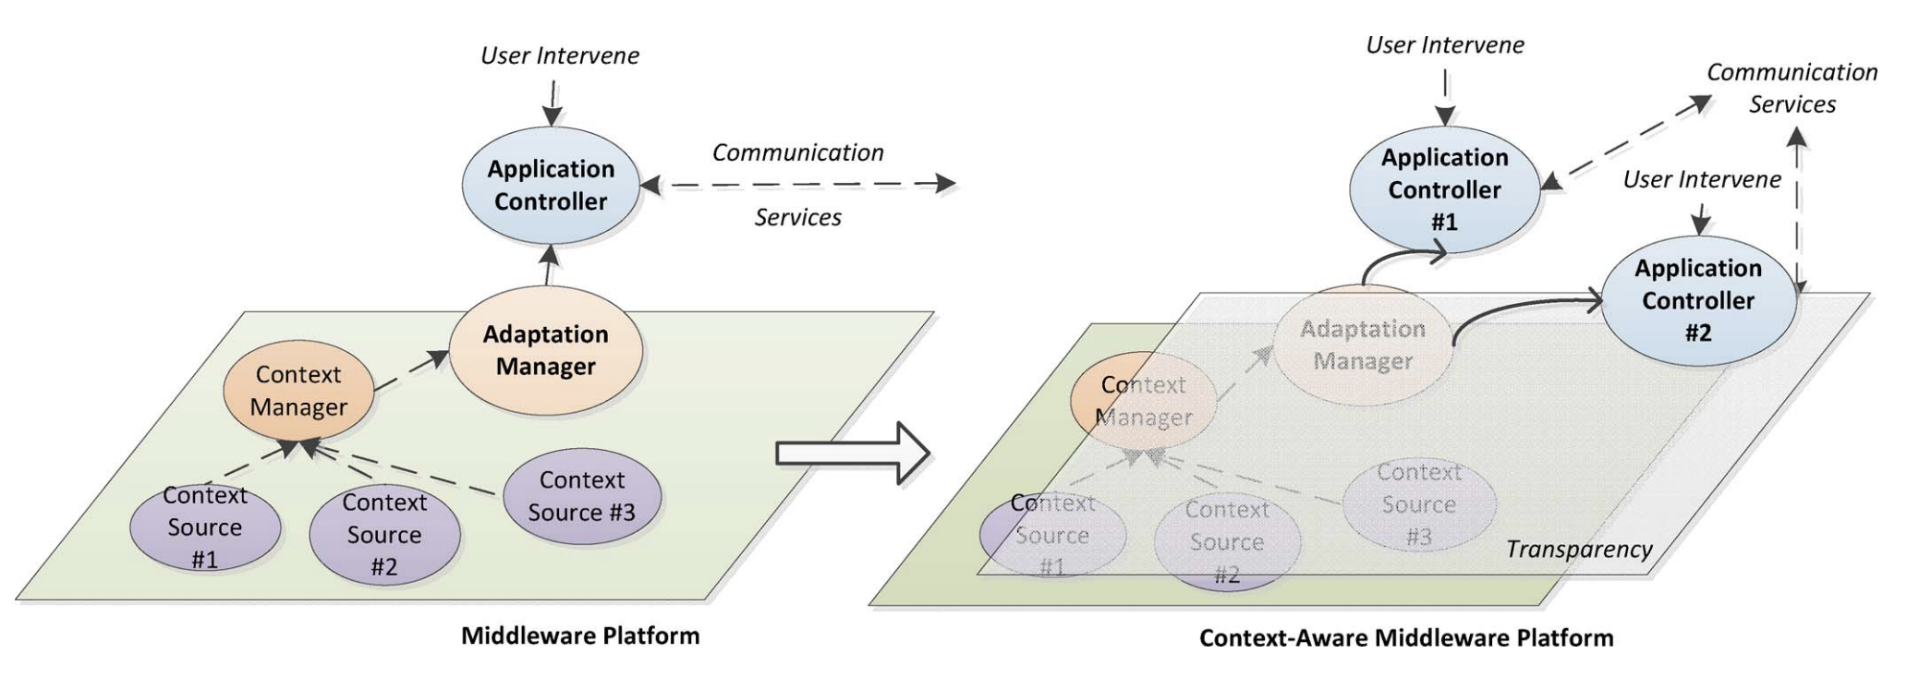
A Typical Context-Aware Middleware
Source: https://ieeexplore.ieee.org/stamp/stamp.jsp?arnumber=6985718

Slide 15
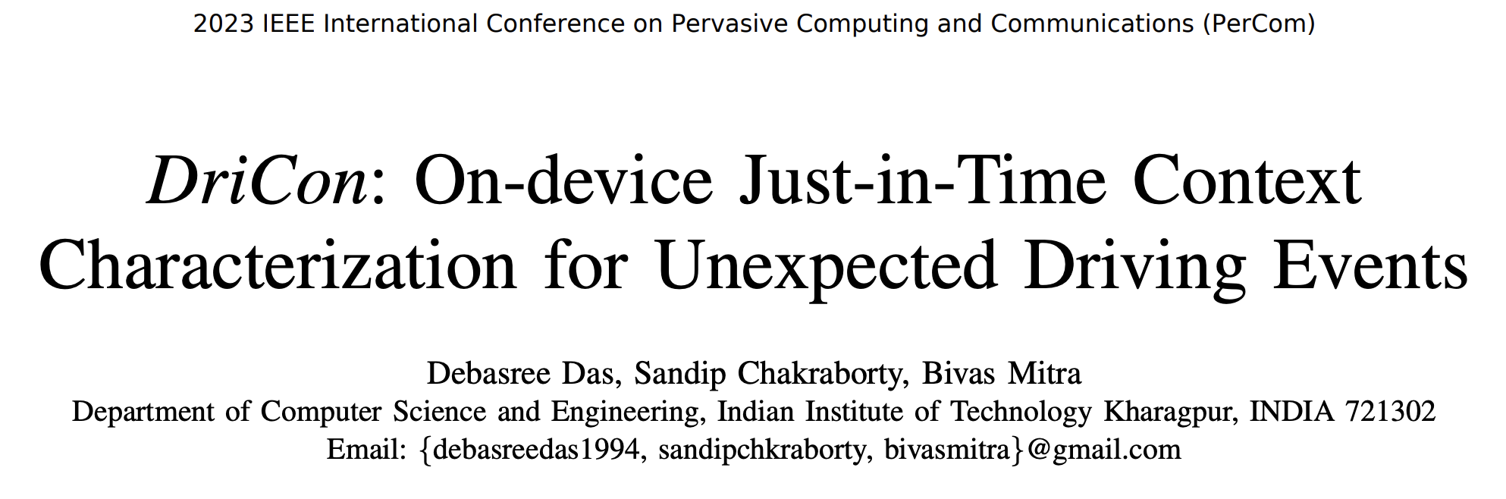

How Context-Awareness Help in Smart and Safe Driving

Slide 16
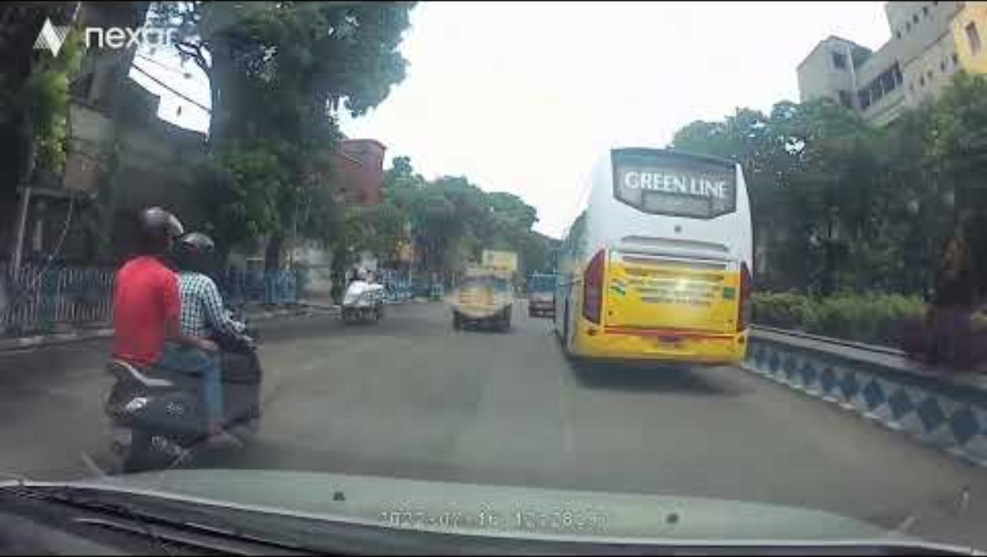
Can My Smartphone Mark My Uber Driver as Good/Bad?

Slide 17
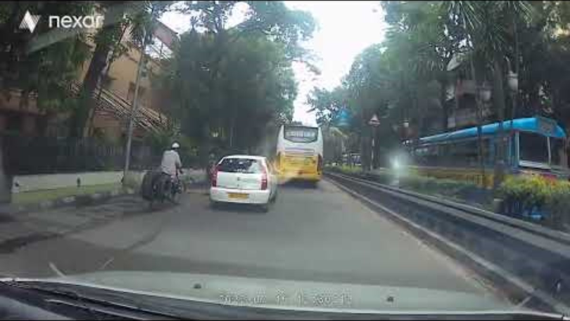
Can My Smartphone Mark My Uber Driver as Good/Bad?

Slide 18
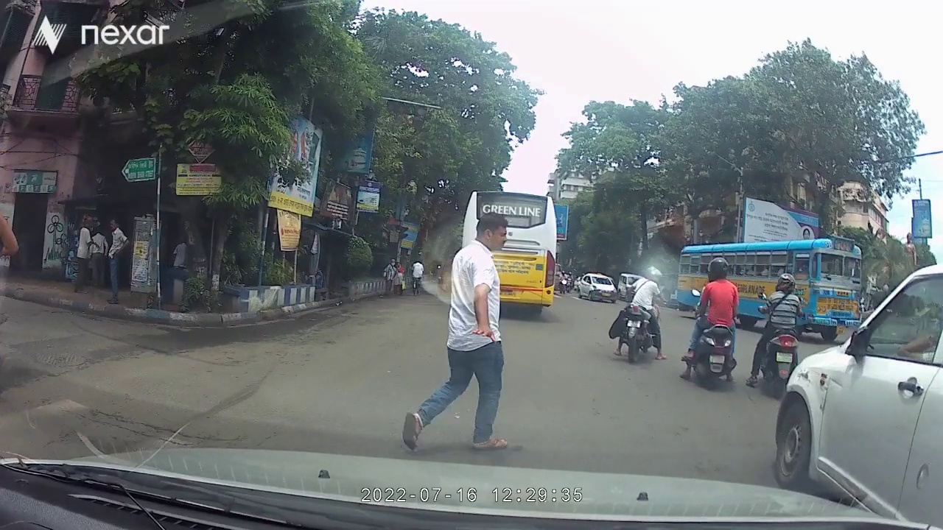
Can My Smartphone Mark My Uber Driver as Good/Bad?
Who is at the fault?
Maneuvers
Driver
Pedestrian
Micro-event
Crossing Pedestrian
Vehicle Abruptly Stops

Slide 19
Can My Smartphone Mark My Uber Driver as Good/Bad?
How Can we Infer Such Contexts?
Maneuvers
Driver
Pedestrian
Micro-event
Crossing Pedestrian
Vehicle Abruptly Stops

Slide 20
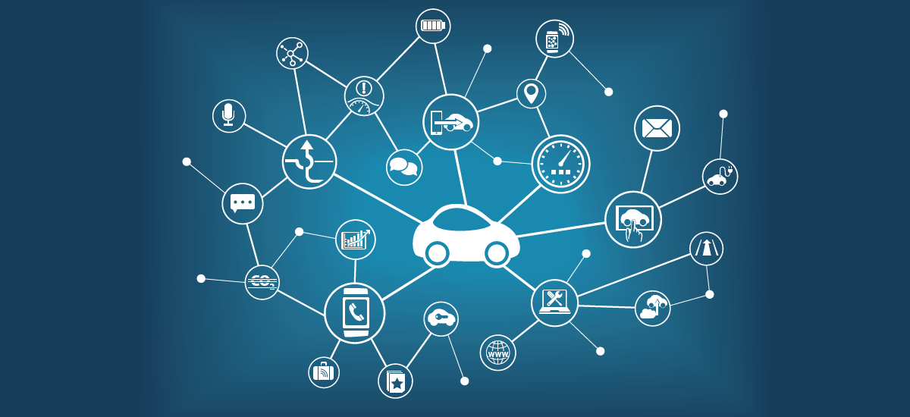

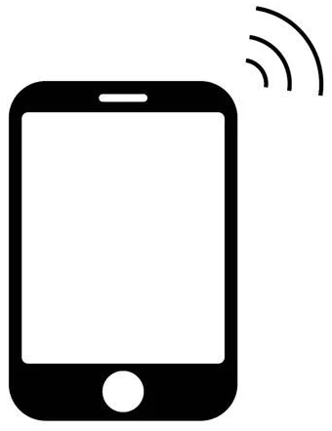
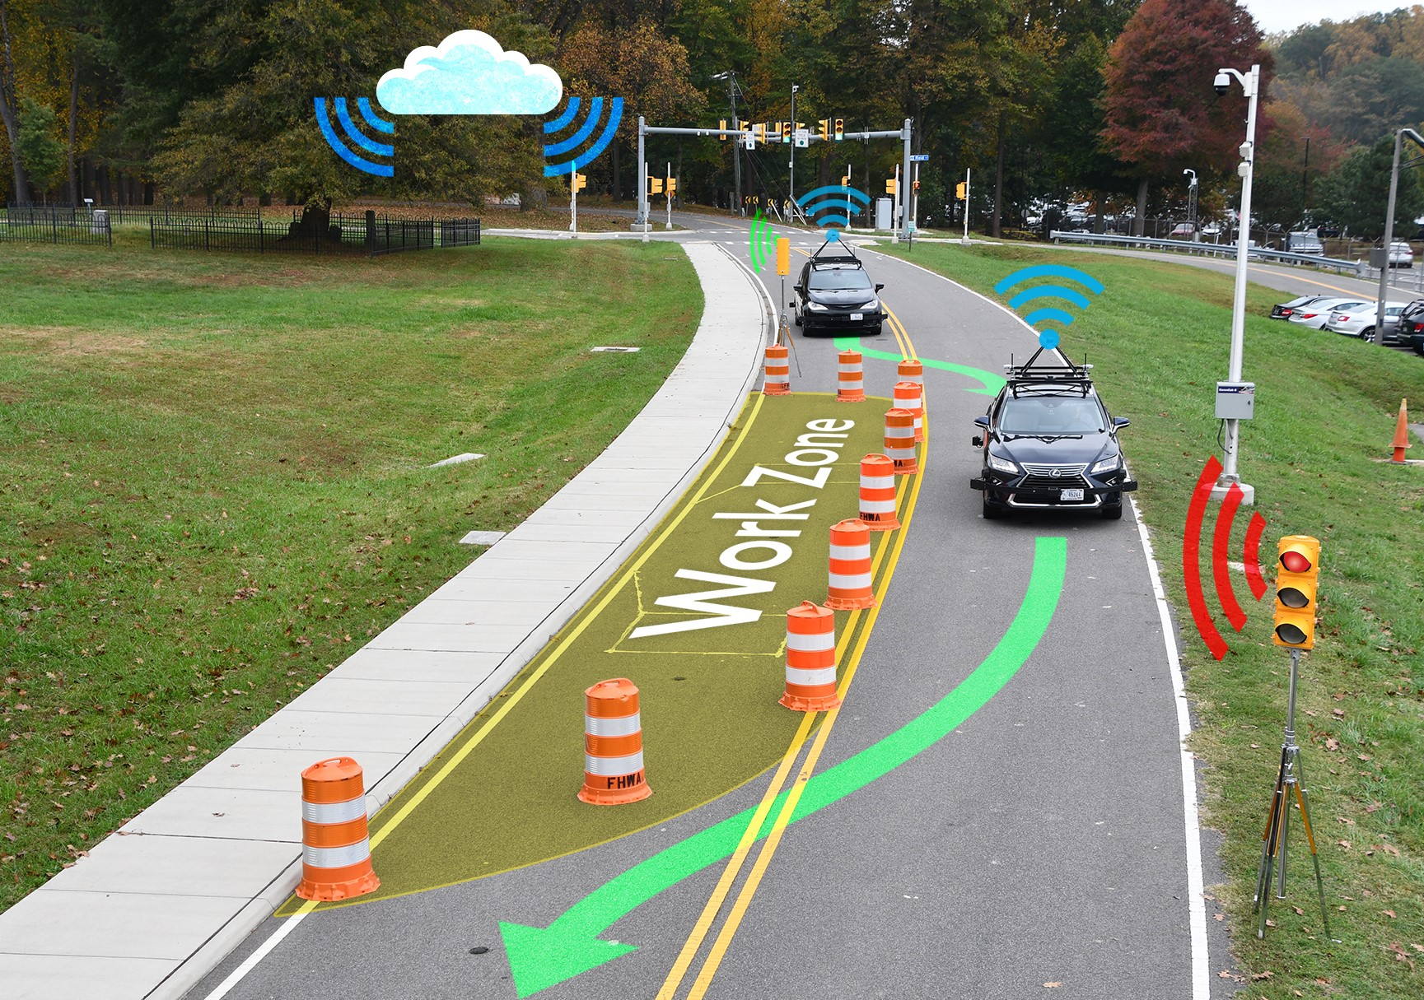
Existing Modalities to Solve This Problem
[1]
[2]
[1] SigSpatial 2017: Understand Reasoning behind Slowdown, Congestion.
[2] TUAT 2017: Analyzes Drive Recorders from Taxis
[3]
[4]
[3] AutomotiveUI 2019: Tracks Cooperative Overtaking for Connected Vehicles
[4] CVPR 2018: Causal Reasoning behind Driving Behavior

Slide 21



Existing Modalities to Solve This Problem
[1]
[2]
[1] No surrounding traffic information
[2] Manual and offline analysis
[3]
[4]
[3] Needs connected vehicles
[4] Human annotation and limited resoning

Slide 22
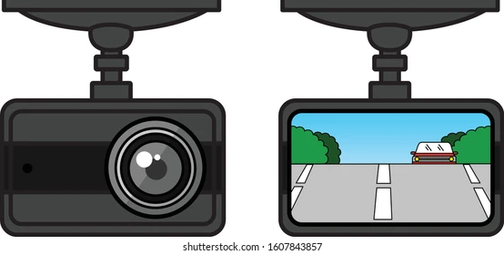
How Can We Sense the Environment?
Wait!! A smart DashCam can sense both in-vehicle and surrounding!!!
Can we use a smart dash-cam to understand the context behind poor driving behavior?

Slide 23
How Can We Sense the Environment?
Wait!! A smart DashCam can sense both in-vehicle and surrounding!!!
Objective: Develop a Proof-of-Concept model to detect the context in terms of interaction with surrounding traffic behind degraded driving behavior and generate human explainable output on the fly
Can we use a smart dash-cam to understand the context behind poor driving behavior?

Slide 24
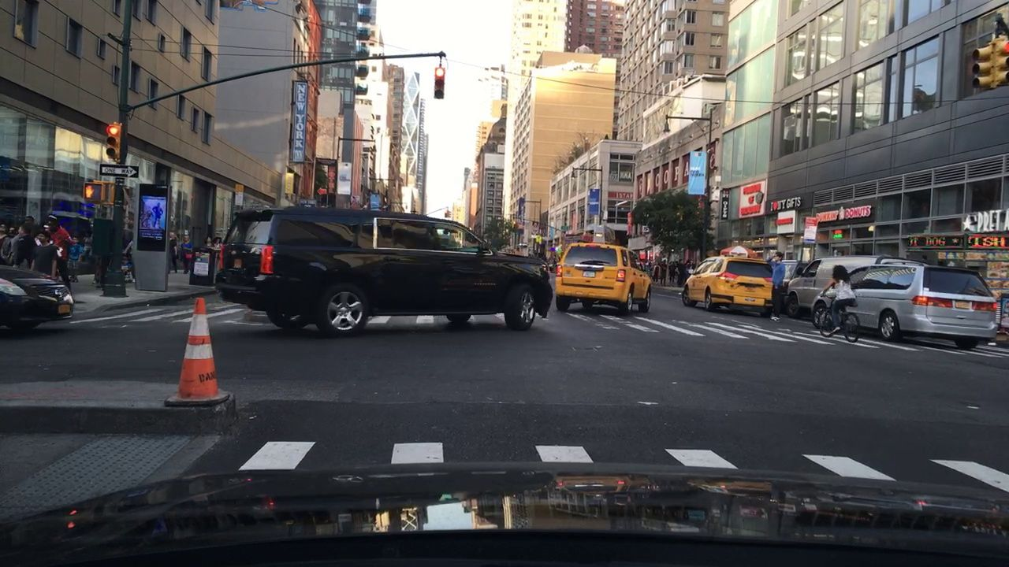
Dataset Used
Public Dataset
Accelerometer | Gyroscope | GPS
Road type | Time of the day | Weather
Video data captured through rear camera |  |  | Driving Score^{[2]}
A Snapshot of the BDD Dataset
We use Berkeley DeepDrive (BDD)^{[1]} dataset covering USA and Israel and comprises 100k trips
[1] F. Yu, H. Chen, X. Wang, W. Xian, Y. Chen, F. Liu, V. Madhavan, and T. Darrell. Bdd100k: A diverse driving dataset for heterogeneous multitask learning. In IEEE CVPR, 2020.
[2] D. Das, S. Pargal, S. Chakraborty, and B. Mitra. Dribe: on-road mobile telemetry for locality-neutral driving behavior annotation. In 23rd IEEE MDM, 2022.

Slide 25
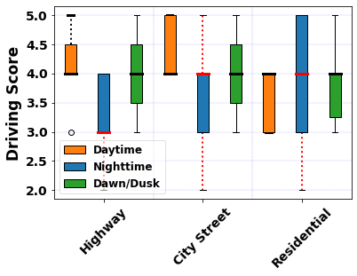
Pilot Study
Driving behavior variation over space and time
Two parameters are varied:
  Road Type (“Highway”, “City Street”, “Residential”)
  Time of the Day (“Daytime”, “Nighttime”, “Dawn/Dusk”)
Good
Bad

Slide 26
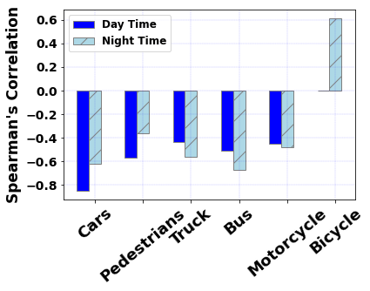
Pilot Study
Impact of Spatial Micro-events on driving behavior
Spearman’s Correlation is computed to see the significance
Observation differs for time of the day

Slide 27
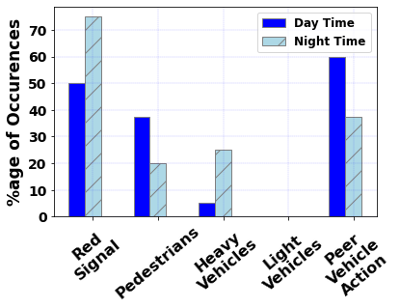
Pilot Study
What are the Spatial Micro-events responsible behind a driving maneuver?
Use Case: Abrupt Stop
Not all of them are equally responsible

Slide 28
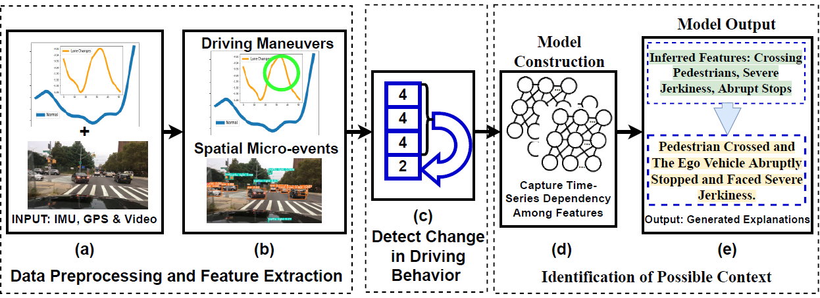
DriCon Overview
Driving Maneuvers
Weave
Swerve
Sideslip
Abrupt Stop
Sharp Turn
Severe Jerkiness
We extract a set of well-known driving maneuvers

Slide 29
DriCon Overview
Spatial Micro-events
Spatial Micro-events are classified among Action of Preceding Vehicle, Peer Vehicles, Pedestrians, Static Road Attributes & Weather Condition
Relative Speed
Relative Distance
Prec. Vehicle Brake
Congestion
Pedestrian
Pedestrian’s Speed
Traffic Light
Type of Road
Heavy Vehicle
Weather Condition

Slide 30
DriCon Overview
Opportunistically detect the change in driving behavior
Design a model which can identify the responsible features

Slide 31
DriCon Overview
Generate human-interpretable explanation​

Slide 32
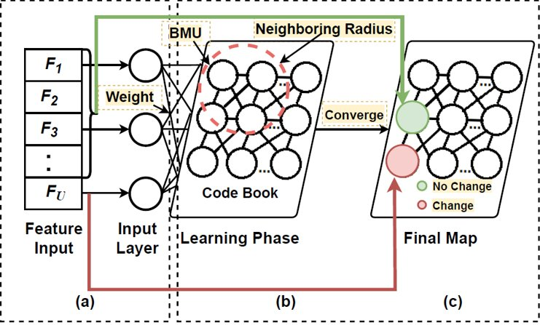
Methodology
Lightweight ANN model is chosen
Self Organizing Maps is utilized
Unsupervised technique applied to learn feature dependency

Slide 33
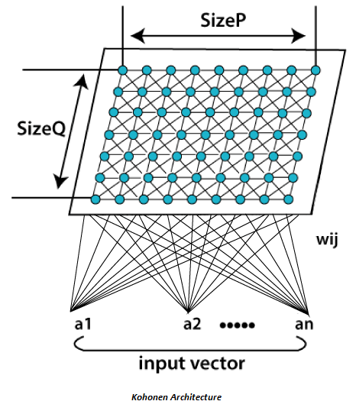
What is a Self-Organizing Map (SOM)
An unsupervised neural network algorithm that is used for data visualization, clustering, and dimensionality reduction
  Also known as a Kohonen Map or Kohonen Network
  It organizes data into a two-dimensional grid,
  preserving the topological structure of the input
  data as much as possible
SOMs maintain the spatial relationships in
the data.
  Points that are close in the input space are mapped
  to neighboring neurons on the 2D grid, preserving the
  similarity in a low-dimensional representation

Slide 34
How A SOM Works
Initialization
  Each neuron in the SOM grid is initialized with a random weight vector, with the same dimension as the input data
Input Data Presentation
  For each input vector in the dataset, the algorithm finds the Best Matching Unit (BMU), which is the neuron whose weight vector is closest to the input vector (usually by Euclidean distance).

Slide 35
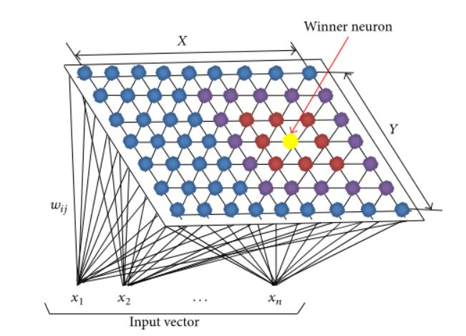
How A SOM Works
Initialization
  Each neuron in the SOM grid is initialized with a random weight vector, with the same dimension as the input data
Input Data Presentation
  For each input vector in the dataset, the algorithm finds the Best Matching Unit (BMU), which is the neuron whose weight vector is closest to the input vector (usually by Euclidean distance).
Updating Wights
  The weight vector of the BMU and its neighboring neurons are updated to become more similar to the input vector. The amount by which the weights are updated is determined by a learning rate and a neighborhood function.
  The neighborhood function determines the radius around the BMU within which neurons are affected, and it usually decreases over time, so that the map gradually refines itself.

Slide 36
How A SOM Works
Iteration
  The process is repeated for multiple iterations, with the learning rate and neighborhood size decreasing gradually, allowing the map to stabilize.
Convergence
  After sufficient iterations, the SOM reaches convergence, meaning the neurons' weight vectors have adapted to the input data's distribution.
  Similar data points are mapped to nearby neurons, creating a structured, low-dimensional representation of the data.

Slide 37
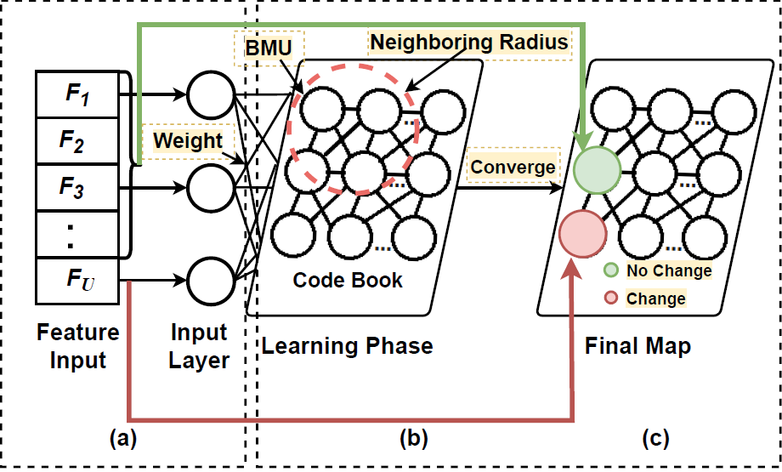
SOM in DriCon
A codebook (2D Grid) with 147 neurons are implemented
Neurons are spread over 7 x 21 2-D array
Past Window Length
Feature Dimension

Slide 38
SOM in DriCon
Each window Fi 𝞊 (f1 ⋃ f2 ⋃ … ⋃ fn)
fi is either driving maneuver or spatial micro-event
Feature vector at windows [1… (U-1)] gets mapped to one unit
Feature vector at window U gets mapped to a different unit

Slide 39
SOM in DriCon
Finally, we get the codebook upon convergence
For each trip instance, we get one neuron which is the Best Matching Unit (BMU) for our SOM structure
BMU

Slide 40
SOM in DriCon
f₁ | f₂ | … | f_{n}
Feature Encoding
BMU
w₁ | w₂ | … | w_{n}
Weight Vector
From the BMU, we get the weight vector and feature encoding
Extract top-k features with higher weights; keep in F_{GEN}

Slide 41
SOM in DriCon
f₁ | f₂ | … | f_{n}
Feature Encoding
BMU
w₁ | w₂ | … | w_{n}
Weight Vector
Determine if feature is an action or subject
Depending upon maneuver or micro-event
For action, use “ego vehicle” as the subject and describing action
For subject, use TF-IDF vectorizer for curating similar guidelines
Sample Output: “jerks”→“the ego vehicle severely jerks”

Slide 42
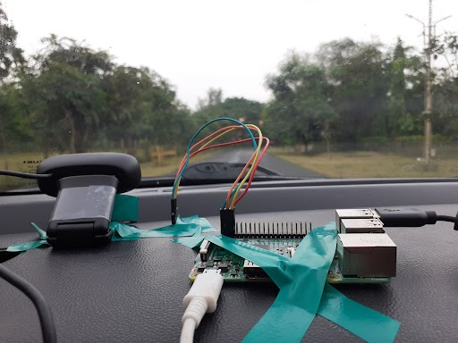
Evaluation Setup
Edge Device | Raspberry PI 3 Model B
OS | Linux kernel version 5.15.65 − v7+
Primary Memory | 1 GB | Processor | ARMv7
Sensors | MPU−9250 IMU, u-blox NEO−6M GPS & Logitech USB camera | Driving Data | 33 Hours
Type of Vehicles | SUV, Sedan & Hatchback | #Cities | 3
#Drivers | 6 (5 Male & 1 Female) | #Type of Road | 3

Slide 43
Evaluation Setup
Each of the video clip is annotated by at least 3 annotators
They have chosen the most relevant factors
Validated factors (using majority voting) are kept at F_{GT}
Dice Coefficient is used between F_{GT} and F_{GEN}
Choose the most relevant ones
Lane Change
Congestion
Taking Abrupt Stops
Choose Factors
Total 15 Factors
…

Slide 44
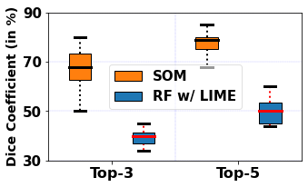
Evaluation Results
Human Annotated (F_{GT}) vs DriCon Generated (F_{GEN}) Feature similarity
Supervised (RF with LIME) vs Unsupervised (SOM)
Achieved a maximum percentage similarity of 79% using SOM
Instance# | Human Annotated (F_{GT}) | Model Generated (F_{GEN}) | Similarity (in %) | ATE^{[1]}
1 | Sideslip, Taking Abrupt Stop, Traffic Lights: Red | Traffic Lights: Red, Congestion, Abrupt Stop | 66.67% | 2.5

Slide 45
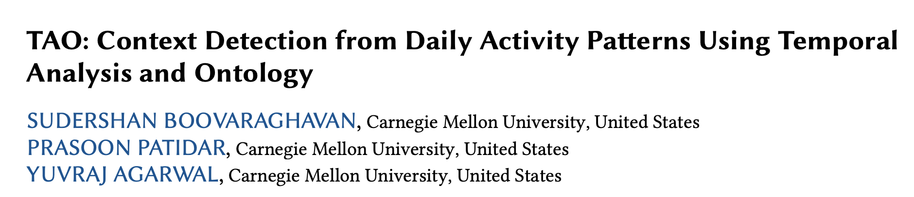

Inferring Contexts
ACM IMWUT 2023

Slide 46
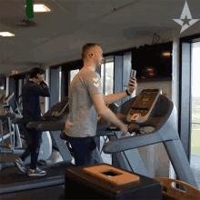
Activity to Context
Activities detected:
(1) Taking over the Phone
(2) Exercise

Slide 47
Activity to Context
Activities detected:
(1) Taking over the Phone
(2) Exercise
Context:
"on a phone call for 20 minutes while exercising"

Slide 48
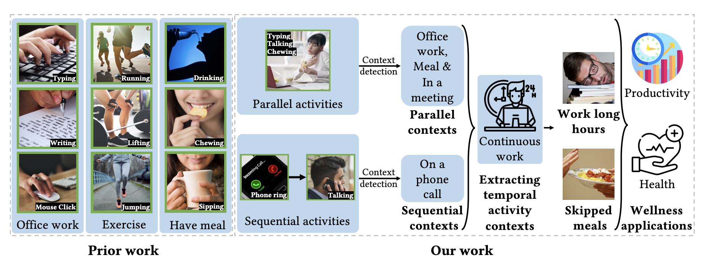
Inferring Context from Spatio-temporal Activity Sequence
TAO

Slide 49
Ontology-based Framework to Model Contexts
An ontology is a structured framework to represent knowledge, typically consisting of classes (concepts), properties (relationships), and individuals (instances)
Web Ontology Language (OWL)
  A formal language designed for representing rich and complex knowledge about things, groups of things, and relations between them
OWL 2 supports rich expressiveness by allowing complex class descriptions, property characteristics (like symmetry, transitivity), and constraints

Slide 50
OWL 2 Example
Ontology for different types of animals and their characteristics, such as “Mammal,” “Bird,” and “Fish,” along with some specific animals like “Dolphin” and “Penguin.”
Classes:
  Animal: The root class representing all animals.
  Mammal, Bird, Fish: Subclasses of Animal.
  Dolphin: A subclass of Mammal.
  Penguin: A subclass of Bird.

Slide 51
OWL 2 Example
Properties:
  hasWarmBlood: A property indicating whether an animal is warm-blooded.
  canFly: A property indicating whether an animal can fly.
  livesInWater: A property indicating whether an animal lives in water.
Individuals:
  Flipper: An individual of the class Dolphin.
  Pingu: An individual of the class Penguin.

Slide 52
OWL 2 Example (OWL 2 Axioms)
Define Class Hierarchy (SubClassOf)
  Mammal SubClassOf Animal
  Bird SubClassOf Animal
  Fish SubClassOf Animal
  Dolphin SubClassOf Mammal
  Penguin SubClassOf Bird

Slide 53
OWL 2 Example (OWL 2 Axioms)
2. Define Properties and Their Characteristics
Define Domains and Ranges:
  hasWarmBlood Domain Animal, Range Boolean
  canFly Domain Animal, Range Boolean
  livesInWater Domain Animal, Range Boolean
Assign Characteristics to Classes:
  Mammal hasWarmBlood true (All mammals are warm-blooded)
  Bird hasWarmBlood true (All birds are warm-blooded)
  Fish hasWarmBlood false (All fish are not warm-blooded)
  Bird canFly true (All birds can fly, but ...)
  Penguin canFly false (Penguins are an exception; they cannot fly)

Slide 54
OWL 2 Example (OWL 2 Axioms)
3. Define Individuals and Their Properties
Flipper (Instance of Dolphin):
  Flipper Type Dolphin
  Flipper livesInWater true
Pingu (Instance of Penguin):
  Pingu Type Penguin
  Pingu livesInWater false

Slide 55
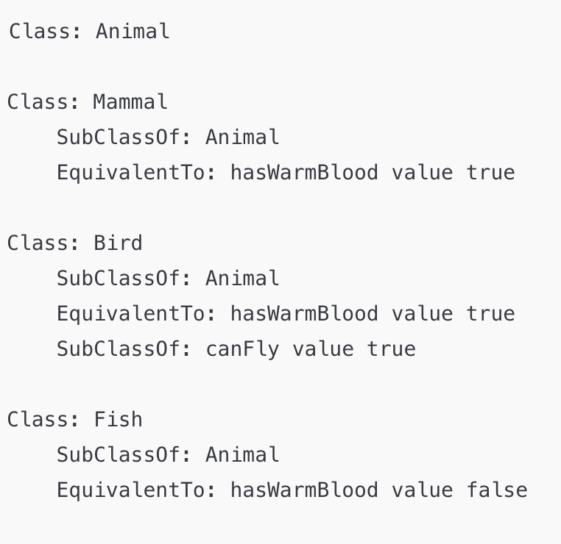
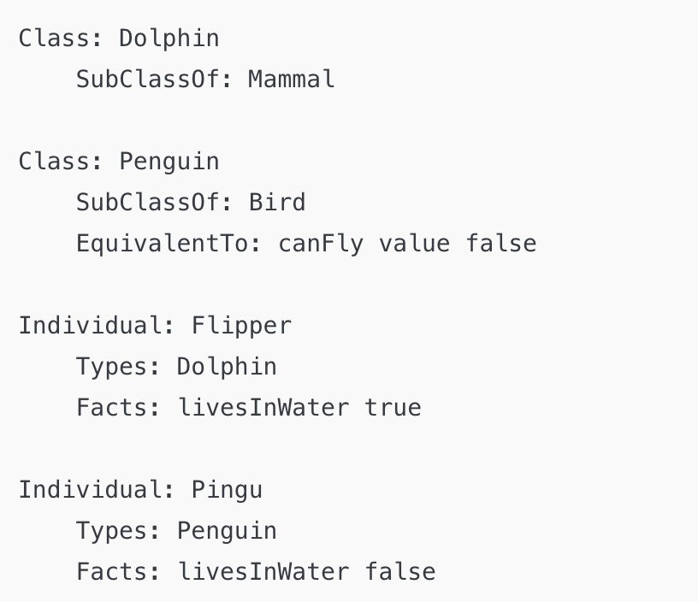
OWL 2 Functional Syntax

Slide 56
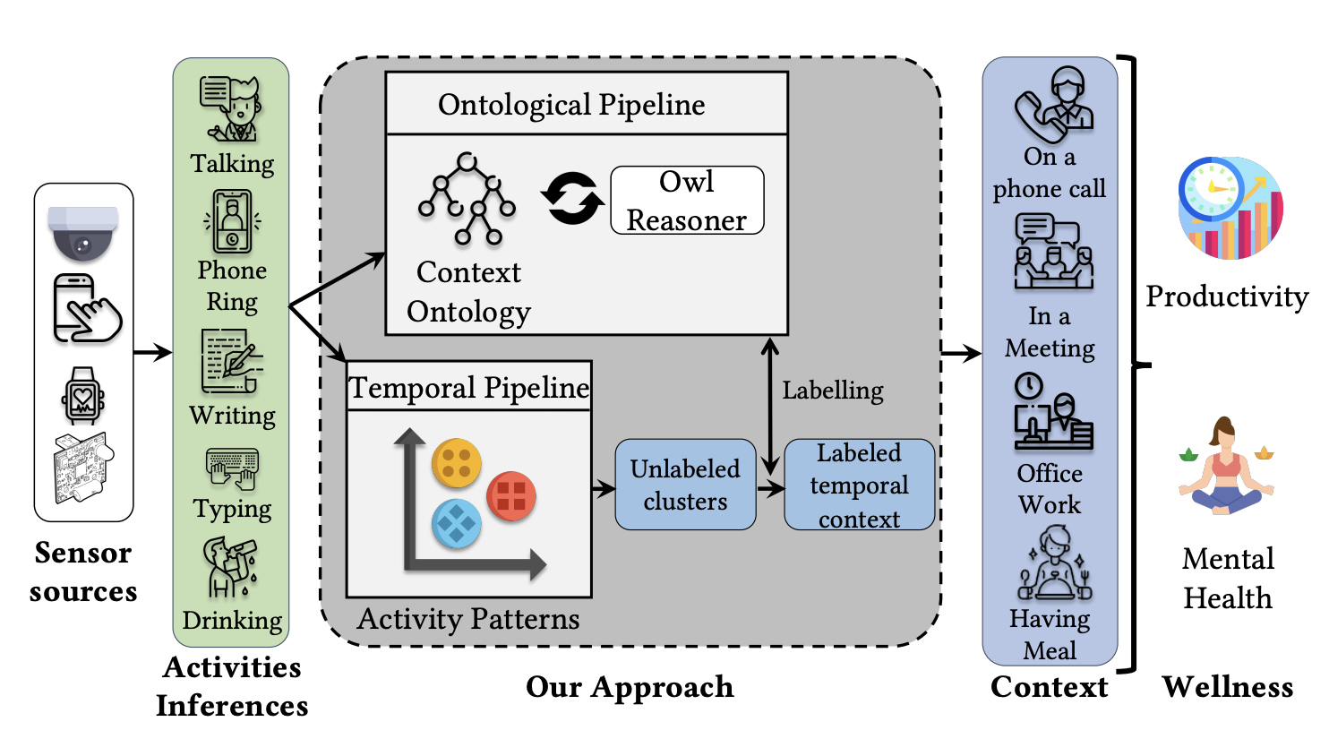
TAO's System Architecture
TAO

Slide 57
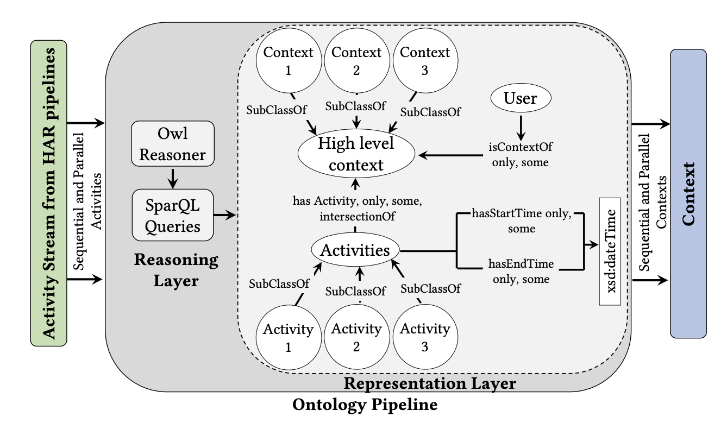
Ontological Pipeline

Slide 58
Context Characterization
Contexts based on the sequential activity patterns
  Context: Phone Call
    Phone ring -> Talking
Context based on parallel activity patterns
  Context: In a Meeting
    Talking
    Writing
Context based on variation in the duration of activity
  Context: On a zoom call
    Talking (30 mins)
  Context: On a phone call
    Talking (5 mins)

Slide 59
Inferring the Contexts
SPARQL Protocol and RDF (Resource Description Framework) Query Language
  a query language and protocol used to retrieve and manipulate data stored in RDF format
  RDF triples consist of three parts: subject, predicate, and object, which together represent relationships between resources
SPARQL Query Types
  SELECT: Used to retrieve specific data. It allows you to specify variables to extract and filter specific patterns in the RDF data.
  CONSTRUCT: Allows you to create a new RDF graph based on the results of the query. This is useful for transforming data or creating derived datasets.
  ASK: Returns a boolean result (TRUE or FALSE) indicating whether any data matches the query pattern. This is often used to check for the existence of data.
  DESCRIBE: Retrieves information about a resource, typically returning all known triples associated with it.

Slide 60
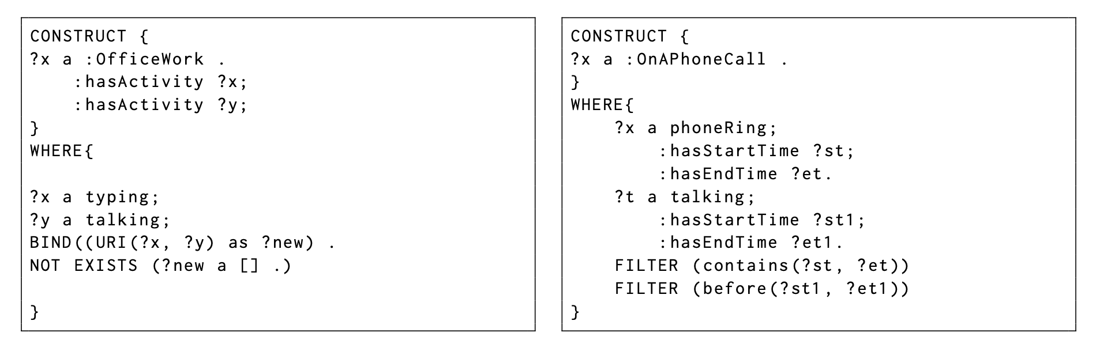
Inferring the Contexts: Activity-Context Binding
SPARQL Query to Infer C: Office Work
SPARQL Query to Infer C: On a Phone Call

Slide 61
Interleaved Contexts
During daily activities, contexts can be overlapped
  Reading and having a meal
  Listening to music while vacuuming
TAO uses a temporal clustering-based approach to detect such interleaved and recurring patterns
  Uses a stacking window (the time interval to wait for receiving activity inferences) and a lag window (incoming activities for a time interval)
  Examples:
    Eating is detected for 5 mins (stack window)
    Eating, listening to music, watching a movie detected for 20 mins (lag window)

Slide 62
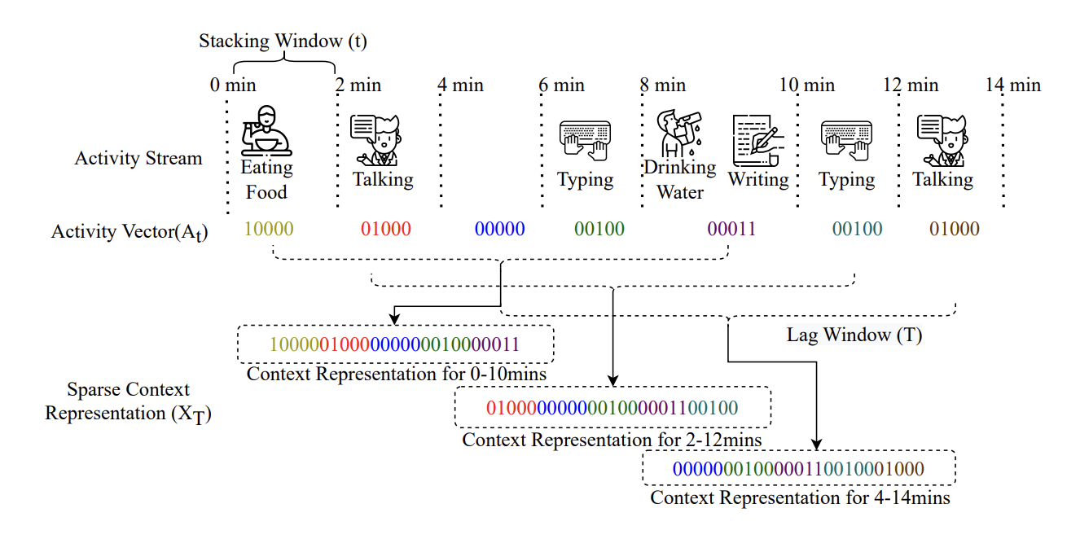
Interleaved Contexts

Slide 63
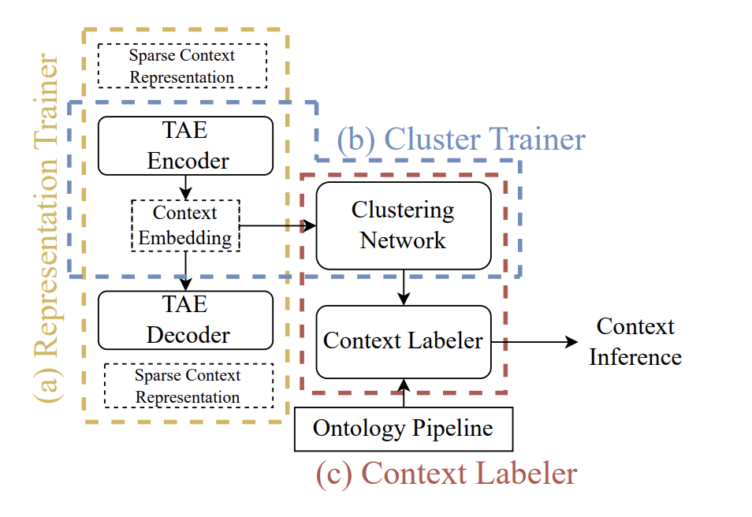
Extracting Contexts
TAO uses a temporal autoencoder (TAE) to encode the similar activity sequences to learn dense context embedding from sparse context (activity) representations
  A clustering is used to discover the
  optimum cluster count to extract
  overlapping context clusters
Example: Jumping->jogging and
jogging->jumping both represents
similar contexts (exercise)

Slide 64
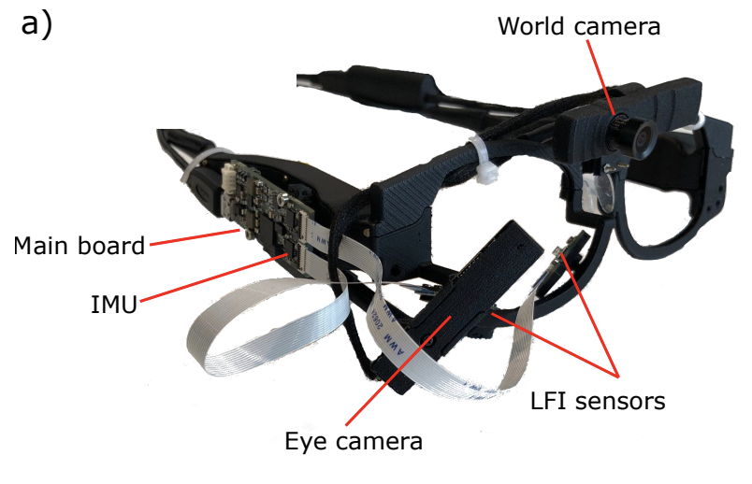
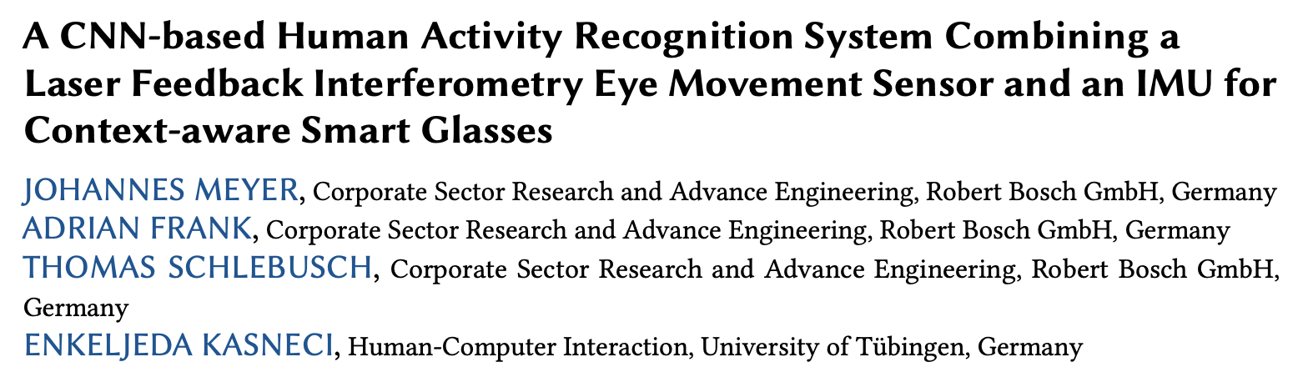
Summary
Contextual information are useful to extract inferences in ubicomp
  Combine multiple sensors together to extract context that can help in inferences
Several use-cases in practical systems
  AR/XR/MR devices: Use eye-gesture to infer emotions and correlate it with activity patterns
  An interesting work to monitor eye gesture and use it as a context behind HAR

Slide 65



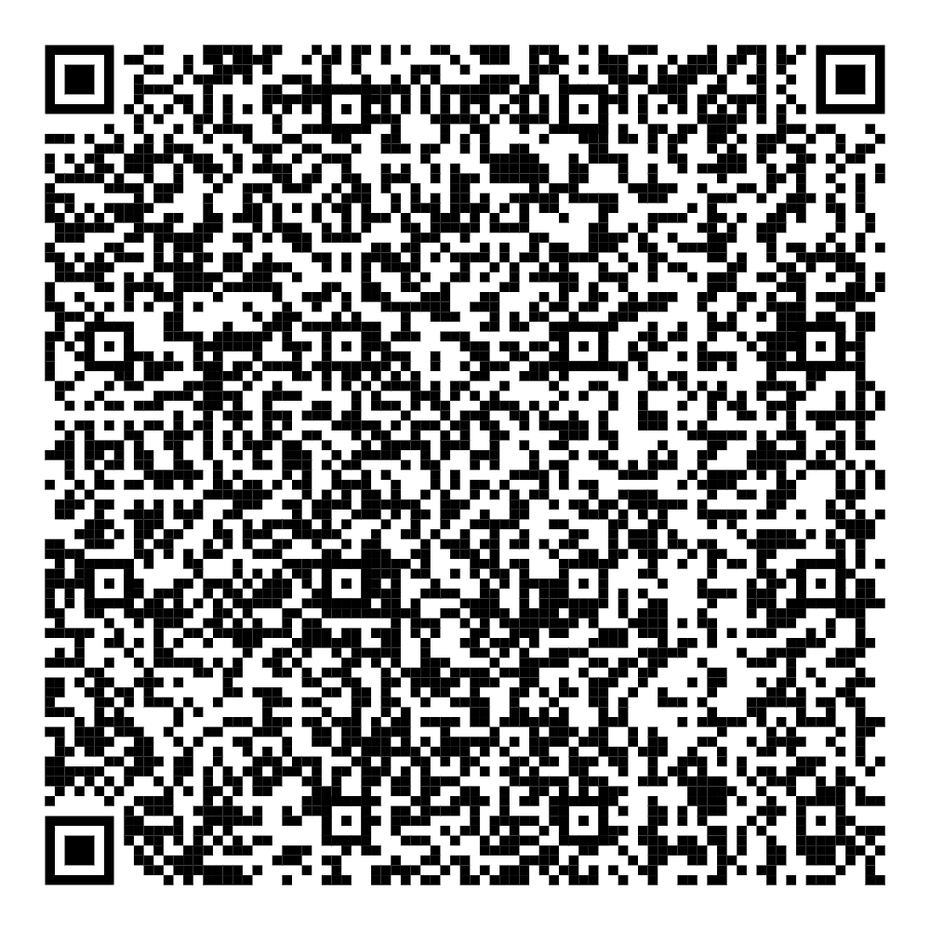
Happy Learning!
Some resources related to this topic

